Slide 1
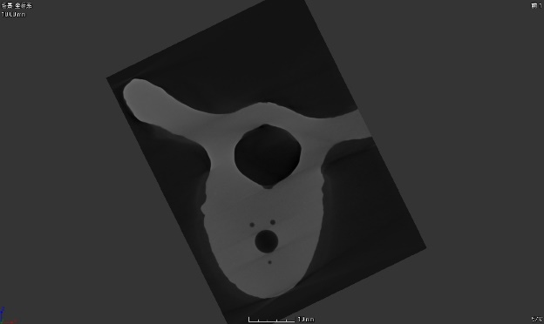
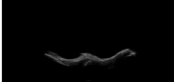
Image registration
？

Slide 2
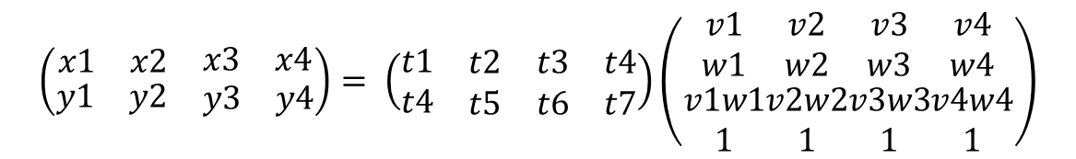
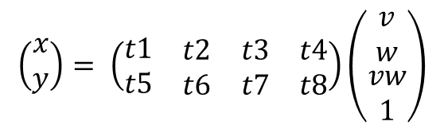
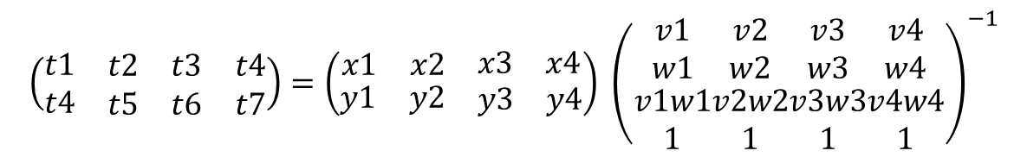
Method
Searching a transformation matrix
$$\left(\begin{matrix}x \\ y\end{matrix}\right)= \left(\begin{matrix}t1 & \begin{matrix}t2 & t3 & t4\end{matrix} \\ t5 & \begin{matrix}t6 & t7 & t8\end{matrix}\end{matrix}\right)\left(\begin{matrix}v \\ w \\ \begin{matrix}vw \\ 1\end{matrix}\end{matrix}\right)$$
$$\left(\begin{matrix}\begin{matrix}\begin{matrix}x1 & x2\end{matrix} & x3 & x4\end{matrix} \\ \begin{matrix}\begin{matrix}y1 & y2\end{matrix} & y3 & y4\end{matrix}\end{matrix}\right)= \left(\begin{matrix}t1 & \begin{matrix}t2 & t3 & t4\end{matrix} \\ t4 & \begin{matrix}t5 & t6 & t7\end{matrix}\end{matrix}\right)\left(\begin{matrix}v1 \\ w1 \\ \begin{matrix}v1w1 \\ 1\end{matrix}\end{matrix}\begin{matrix}v2 \\ w2 \\ \begin{matrix}v2w2 \\ 1\end{matrix}\end{matrix}\begin{matrix}v3 \\ w3 \\ \begin{matrix}v3w3 \\ 1\end{matrix}\end{matrix}\begin{matrix}v4 \\ w4 \\ \begin{matrix}v4w4 \\ 1\end{matrix}\end{matrix}\right)$$
$$\left(\begin{matrix}t1 & \begin{matrix}t2 & t3 & t4\end{matrix} \\ t4 & \begin{matrix}t5 & t6 & t7\end{matrix}\end{matrix}\right)=\left(\begin{matrix}\begin{matrix}\begin{matrix}x1 & x2\end{matrix} & x3 & x4\end{matrix} \\ \begin{matrix}\begin{matrix}y1 & y2\end{matrix} & y3 & y4\end{matrix}\end{matrix}\right) {\left(\begin{matrix}v1 \\ w1 \\ \begin{matrix}v1w1 \\ 1\end{matrix}\end{matrix}\begin{matrix}v2 \\ w2 \\ \begin{matrix}v2w2 \\ 1\end{matrix}\end{matrix}\begin{matrix}v3 \\ w3 \\ \begin{matrix}v3w3 \\ 1\end{matrix}\end{matrix}\begin{matrix}v4 \\ w4 \\ \begin{matrix}v4w4 \\ 1\end{matrix}\end{matrix}\right)}^{−1}$$

Slide 3
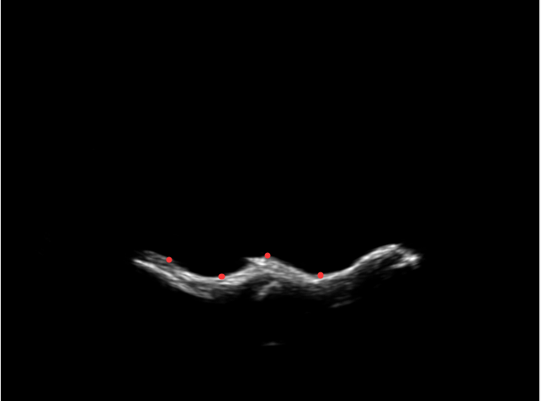
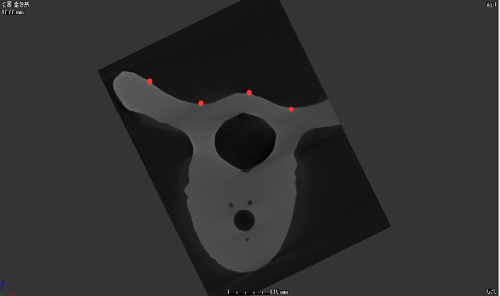
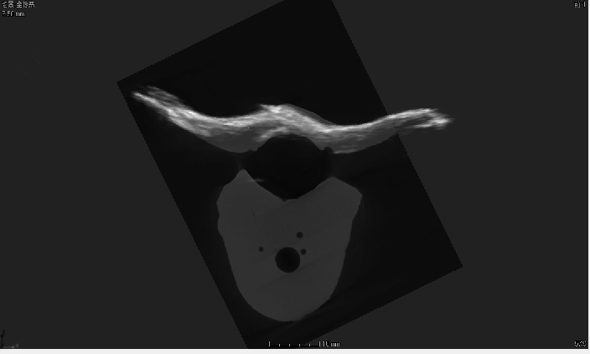
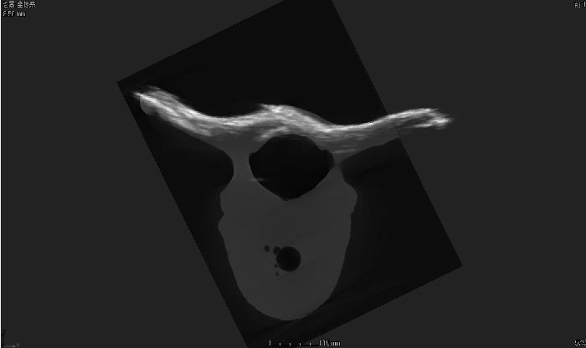
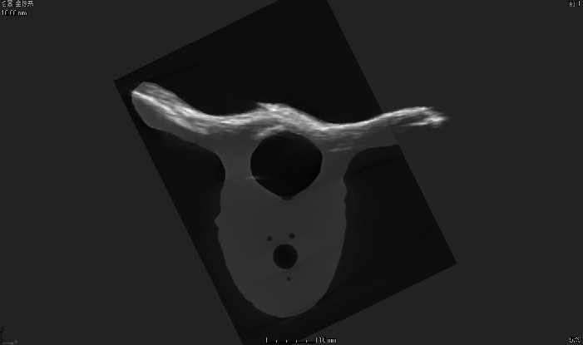
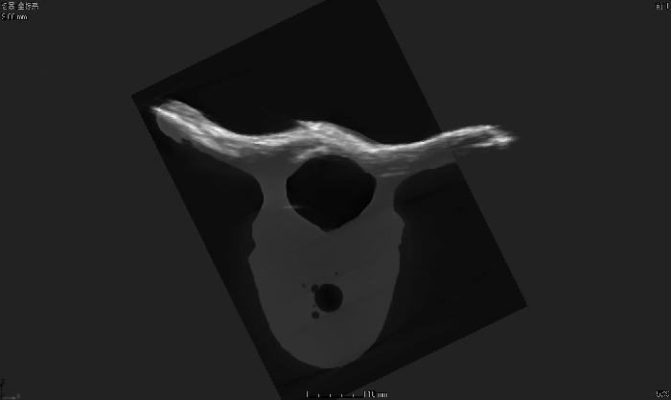

Process
Select points
Result

Slide 4
Discussion
First, I search the local lowest points and the local highest points in the picture.
Second, trying more times is best way to select tie points.
Third, selecting tie points must be careful and focus on the screen. Some points may match some images well, but for another image, it could be bad.

